Slide 1
AI TRAINING PROGRAM · WEEK 5 · PHASE 2
✖
K-Means & DBSCAN
✖
Clustering for Beginners
A hands-on introduction to unsupervised learning — grouping data
without labels, and finding structure no one told the model to look for.
✖
Week 5 — Unsupervised Learning
1

Slide 2






TODAY'S SESSION
What We'll Cover Today
What is Clustering?
K-Means Clustering
Unsupervised learning & real-world use cases
The algorithm, step by step
Choosing K
DBSCAN
Elbow method & silhouette score
Density-based clustering & noise detection
K-Means vs. DBSCAN
Hands-On Project
Side-by-side comparison, when to use which
Customer segmentation notebook
Week 5 — Unsupervised Learning
2

Slide 3

QUICK RECAP
Two Kinds of Learning
Supervised Learning
Unsupervised Learning
You provide labeled examples: inputs paired with the correct answer
Goal: learn a mapping that predicts labels for new, unseen data
Examples covered in Week 4: linear & logistic regression
You provide only raw data — there are no labels at all
Goal: discover hidden structure, groups, or patterns on its own
Today's topic: clustering, with K-Means and DBSCAN
VS
Week 5 — Unsupervised Learning
3

Slide 4



FOUNDATIONS
What Is Clustering?
Clustering groups data points so that items in the same group are as similar as possible, and items in different groups are as different as possible — with no labels to guide it.
Customer Segmentation
Anomaly Detection
Group customers by income & behavior to target marketing
Points that fit no cluster get flagged as outliers or fraud
Image Compression
Document / Topic Clustering
Group similar pixel colors, replace each group with one color
Group articles or support tickets by underlying topic
Week 5 — Unsupervised Learning
4

Slide 5
PART ONE
✖
K-Means Clustering
Group points by distance to a center
✖
✖
Week 5 — Unsupervised Learning
5

Slide 6
K-MEANS · THE ALGORITHM
Five Steps to Convergence
1
→
2
→
3
→
4
→
5
Choose K
Initialize
Assign
Update
Repeat
Decide how many
clusters to find
Randomly place
K centroids
Each point joins its
nearest centroid
Move centroids to the
mean of their points
Until centroids
stop moving
Steps 3 – 4 repeat until the assignments no longer change.
Objective: minimize the total squared distance from every point to its own cluster's centroid (“inertia” / WCSS).
J = Σ Σ ‖ x − μᵢ ‖²
Week 5 — Unsupervised Learning
6

Slide 7
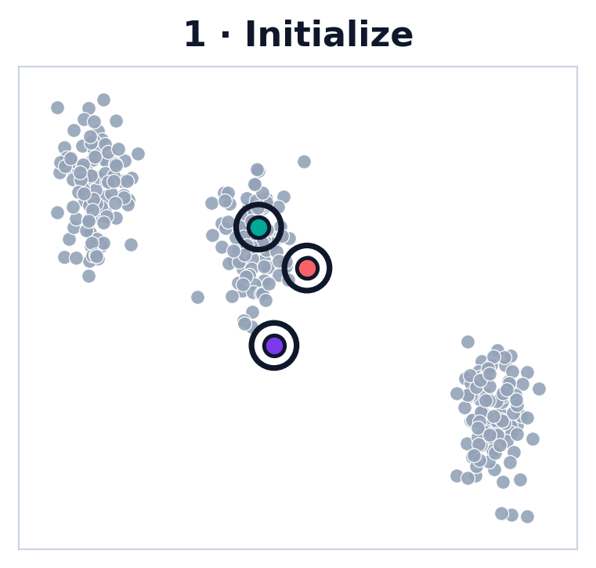
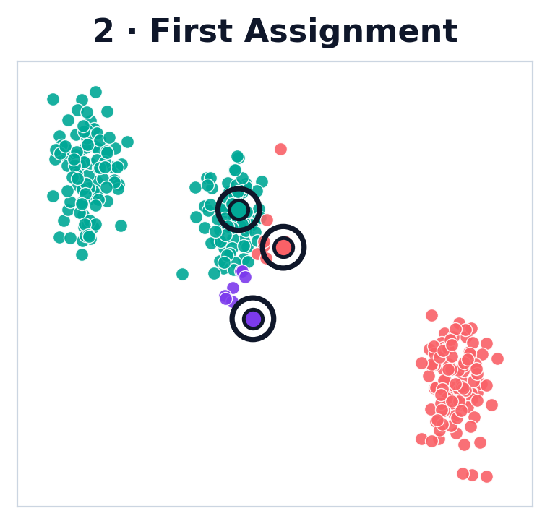
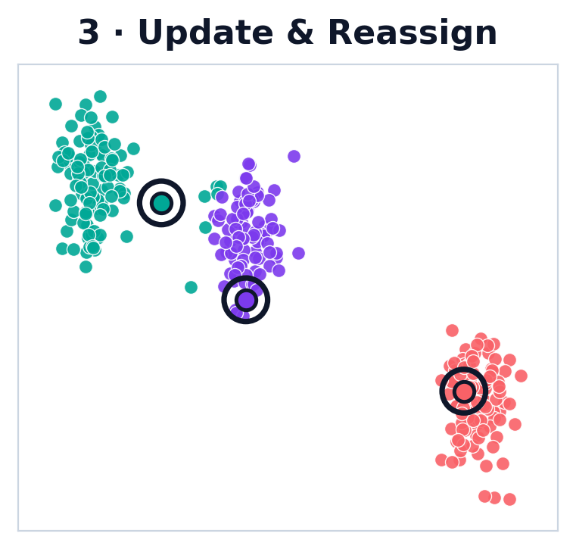
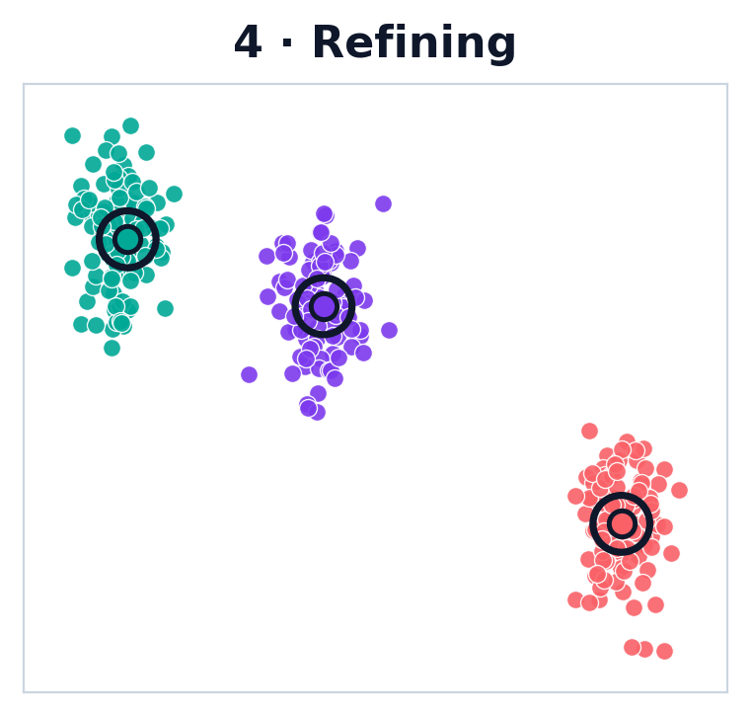
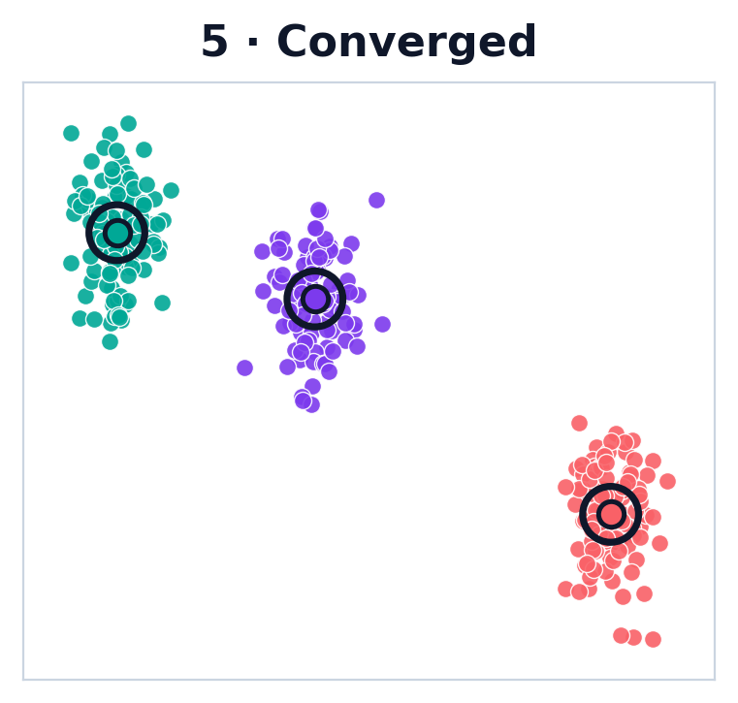
K-MEANS · WATCH IT LEARN
From Random Guess to Convergence
Step 1
Step 2
Step 3
Step 4
Step 5
Same five steps as the previous slide, in action: centroids start in a poor random spot, points are assigned to the nearest one, centroids shift to the mean of their group, and the loop repeats — each pass tightening the fit until assignments stop changing.
Week 5 — Unsupervised Learning
7

Slide 8
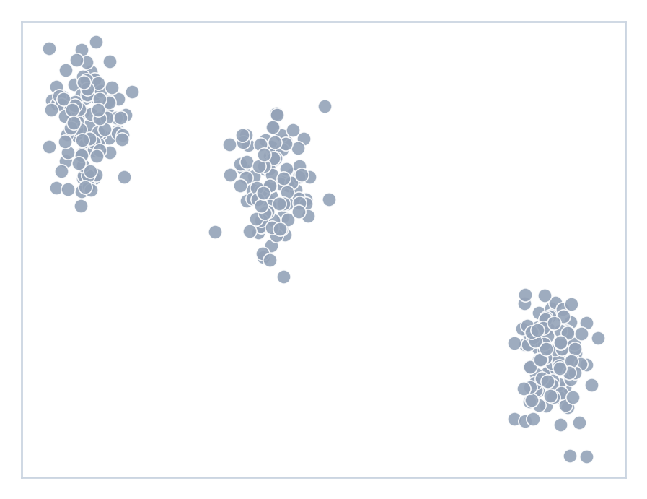
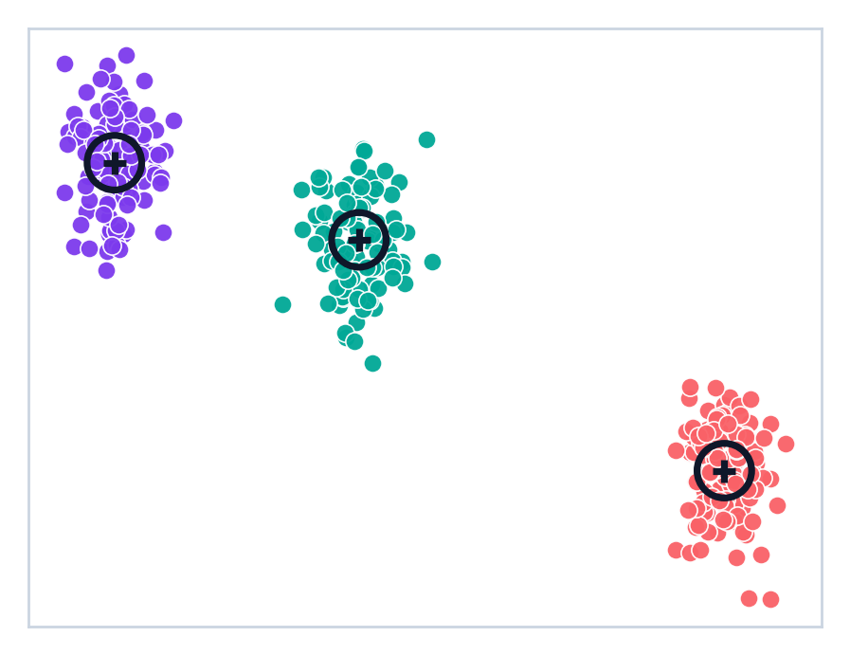
K-MEANS · IN ACTION
From Raw Points to Clusters
BEFORE
AFTER K-MEANS (K=3)
✖
→
✖
→
✖
Week 5 — Unsupervised Learning
8

Slide 9
K-MEANS · MODEL SELECTION
How Many Clusters? Elbow & Silhouette
Elbow Method
Silhouette Score
458
0.70
333
0.62
208
0.53
83
0.45
-42
0.37
1
2
3
4
5
6
7
8
9
10
2
3
4
5
6
7
8
9
10
Number of Clusters (K)
Number of Clusters (K)
Improvement flattens sharply after K = 5
Peaks at K = 5 (score = 0.661)
Week 5 — Unsupervised Learning
9

Slide 10

K-MEANS · TRADE-OFFS
Strengths & Limitations
Strengths
Limitations
Fast and scales well to large datasets
You must choose K in advance
Simple to understand, explain, and implement
Assumes spherical, evenly-sized clusters
Works great when clusters are roughly round and similarly sized
Sensitive to outliers and to how centroids are initialized
Week 5 — Unsupervised Learning
10

Slide 11
PART TWO
DBSCAN
Group points by density, not distance
Week 5 — Unsupervised Learning
11

Slide 12
DBSCAN · CORE CONCEPTS
Core, Border & Noise Points
Two parameters define “dense”:
eps (ε): search radius around each point
ε (eps) radius
Border point
min_samples: minimum points needed within eps to count as dense
Core: ≥ min_samples neighbors within eps Border: fewer neighbors, but within eps of a core point Noise: neither — too far from any dense region
Core point
Noise point
Week 5 — Unsupervised Learning
12

Slide 13
DBSCAN · THE ALGORITHM
Four Steps, No Pre-Set K
1
→
2
→
3
→
4
Pick a point
Count neighbors
Classify
Repeat
Choose any unvisited
point in the data
Count points within
radius eps
Core → grow cluster
Border → join nearby
Otherwise → noise
Until every point
has been visited
Key idea: clusters grow by chaining together dense neighborhoods, so DBSCAN never needs to know the number of clusters in advance — it emerges from the data.
Week 5 — Unsupervised Learning
13

Slide 14
DBSCAN · TRADE-OFFS
Strengths & Limitations
Strengths
Limitations
No need to specify the number of clusters up front
Sensitive to the choice of eps and min_samples
Finds arbitrarily shaped clusters, not just round ones
Struggles when clusters have very different densities
Automatically flags outliers as noise instead of forcing them in
Slower than K-Means on very large or high-dimensional data
Week 5 — Unsupervised Learning
14

Slide 15
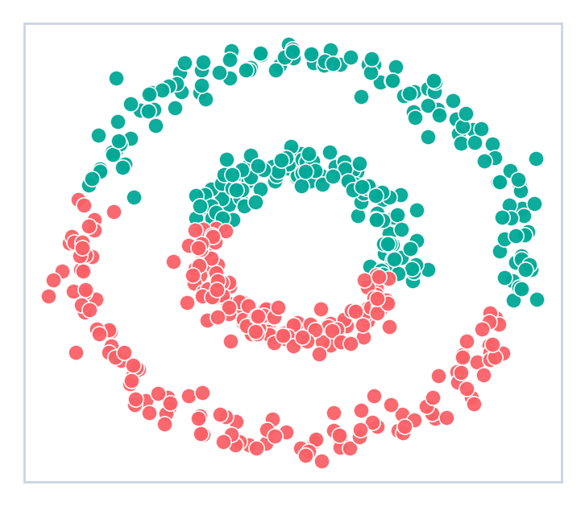
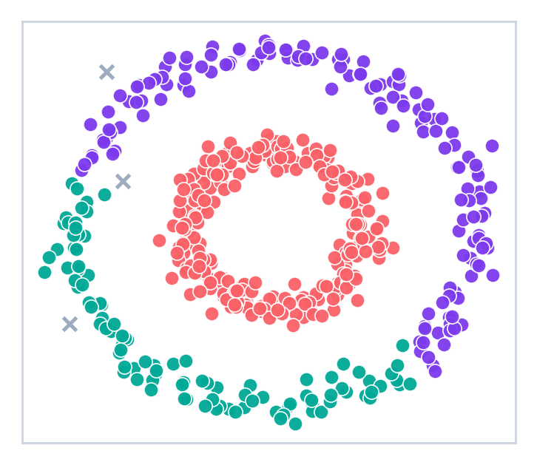
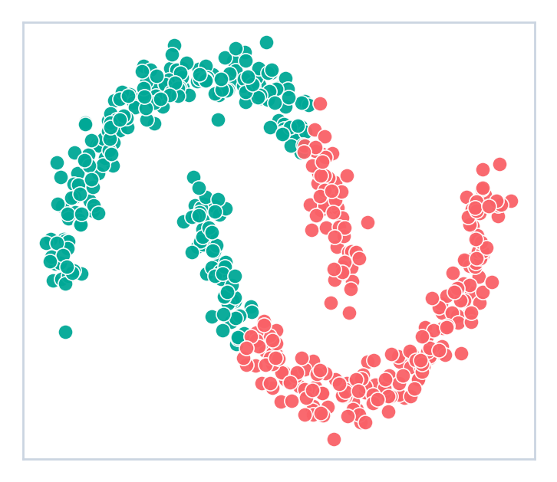
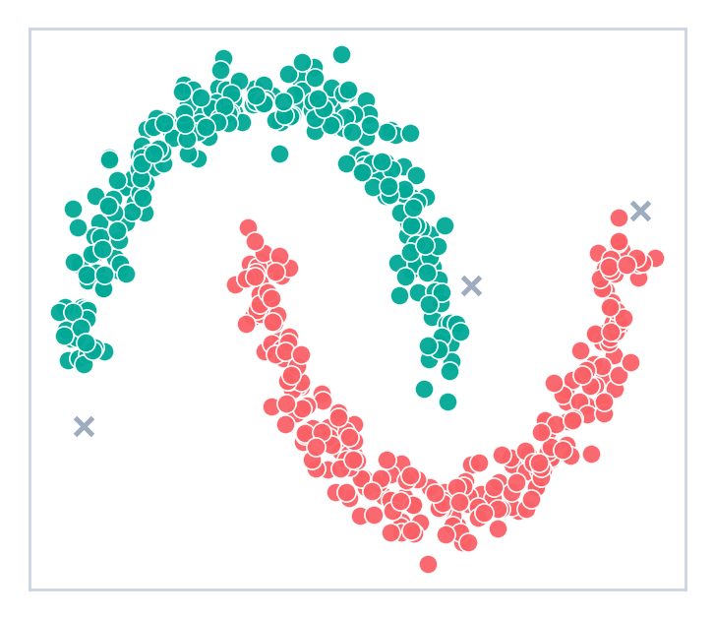
WHERE K-MEANS FAILS
DBSCAN to the Rescue
K-MEANS (K=2)
DBSCAN
Concentric Circles Two nested rings. K-Means cuts them straight down the middle; DBSCAN follows the density and recovers both rings.
Half-Moons Two interleaved crescents. K-Means splits by a straight boundary; DBSCAN traces each arc as one cluster.
Why it happens: K-Means minimizes distance to a centroid, so it can only carve out round, convex blobs. DBSCAN grows clusters through connected dense regions, so shape doesn't matter — and stray points become noise, not forced members.
Week 5 — Unsupervised Learning
15

Slide 16
BRINGING IT TOGETHER
K-Means vs. DBSCAN, Side by Side
 | K-Means | DBSCAN
Number of clusters | You must specify K | Discovered automatically from density
Cluster shape | Assumes spherical / convex | Handles arbitrary shapes
Outliers / noise | Every point forced into a cluster | Explicitly labeled as noise (−1)
Key parameters | K (and n_init) | eps, min_samples
Best for | Well-separated, blob-like groups | Irregular shapes, spatial data, anomaly detection
Week 5 — Unsupervised Learning
16

Slide 17


HANDS-ON PROJECT
Customer Segmentation
Apply K-Means and DBSCAN to a real-shaped retail dataset and turn clusters into customer segments a marketing team could actually use.
Age
Annual Income (k$)
Spending Score (1–100)
Customer age in years
Yearly income, in thousands
Behavior-based score set by the mall
Companion notebook: Week5_KMeans_DBSCAN_Clustering.ipynb
Simulated Mall-Customer-style dataset · full EDA · K-Means from scratch · elbow & silhouette · DBSCAN tuning · practice exercises
Week 5 — Unsupervised Learning
17

Slide 18

WRAP-UP
Key Takeaways
Clustering is unsupervised learning: finding structure in data with no labels
K-Means assigns points to the nearest centroid, then updates centroids, until convergence
Use the Elbow Method and Silhouette Score together to choose a good K
DBSCAN groups by density, finds K automatically, and explicitly flags noise
Always scale your features first — both algorithms rely on distance
There's rarely one “correct” algorithm — try both and compare on your data
Week 5 — Unsupervised Learning
18

Slide 19
COMING UP · WEEK 6 & 7
Neural Networks, CNN & RNN
✖
Perceptron, MLP & backpropagation
CNNs for image classification (CIFAR-10)
RNN / LSTM architectures for sequence data
Project: MNIST classifier + LSTM stock forecaster
✖
You're ready to build.
From raw customer data to actionable segments — in two algorithms.
Week 5 — Unsupervised Learning
19

